Slide 1

File Handling in Python
Dr. Rakhee Chhibber

Slide 2
Introduction
File handling refers to the process of performing operations on a file, such as creating, opening, reading, writing and closing it through a programming interface. It involves managing the data flow between the program and the file system on the storage device, ensuring that data is handled safely and efficiently.

Slide 3
Why do we need File Handling
To store data permanently, even after the program ends.
To access external files like .txt, .csv, .json, etc.
To process large files efficiently without using much memory.
To automate tasks like reading configs or saving outputs.
To handle input/output in real-world applications and tools.

Slide 4
TYPES OF FILES
Text file - Files with extensions like .txt, .py, .csv, etc. are some examples of text files
Binary Files - Binary files are also stored in terms of bytes (0s and 1s), but unlike text files, these bytes do not represent the ASCII values of characters

Slide 5
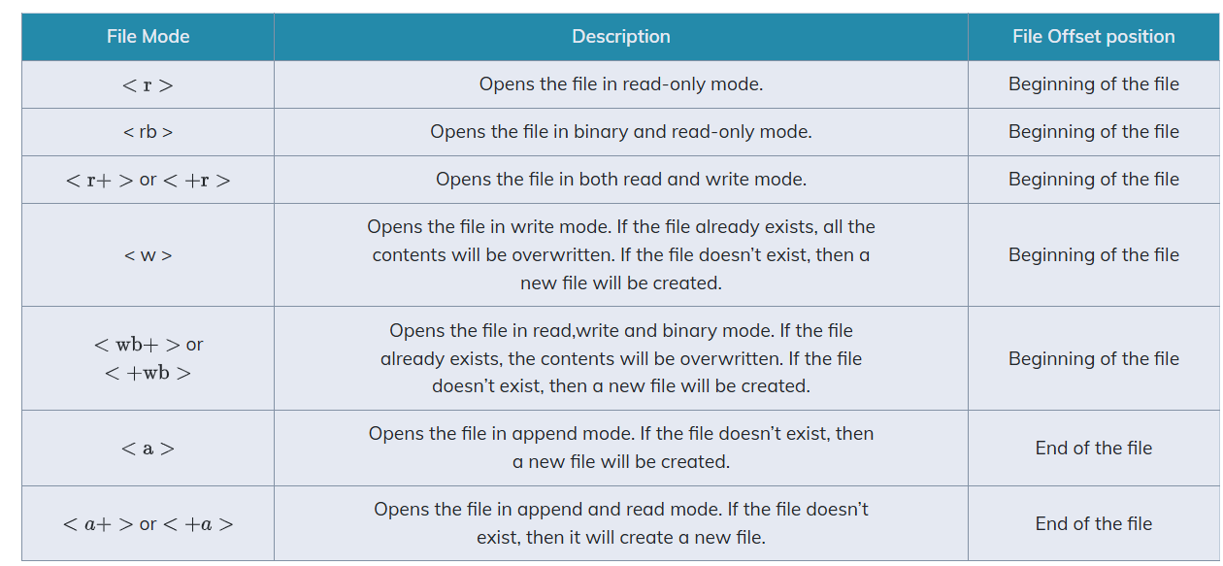
OPENING AND CLOSING A TEXT FILE
Opening a file
file_object= open(file_name, access_mode)
Example - myObject=open(“myfile.txt”, “a+”)

Slide 6
Closing a file
file_object.close ()

Slide 7
Opening a file using with clause
with open (file_name, access_mode) as file object_:
The advantage of using with clause is that any file that is opened using this clause is closed automatically, once the control comes outside the with clause. In case the user forgets to close the file explicitly or if an exception occurs, the file is closed automatically. Also, it provides a simpler syntax.
with open(“myfi le.txt”,”r+”) as myObject: content = myObject.read()

Slide 8
Checking File Properties
f = open("geek.txt", "r")
print("Filename:", f.name)
print("Mode:", f.mode)
print("Is Closed?", f.closed)
f.close()
print("Is Closed?", f.closed)

Slide 9
Write to Text File in Python
Using write()
Using writelines()

Slide 10
Writing to a Python Text File Using write()
write(): Inserts the string str1 in a single line in the text file.
File_object.write(str1)
Example
file = open("Employees.txt", "w")
for i in range(3):
name = input("Enter the name of the employee: ")
file.write(name)
file.write("\n")
file.close()
print("Data is written into the file.")

Slide 11
Writing to a Text File Using writelines()
writelines(): For a list of string elements, each string is inserted in the text file. Used to insert multiple strings at a single time.
Syntax
File_object.writelines(L) for L = [str1,str2,str3]
file1 = open("Employees.txt", "w")
lst = []
for i in range(3):
name = input("Enter the name of the employee: ")
lst.append(name + '\n')
file1.writelines(lst)
file1.close()
print("Data is written into the file.")

Slide 12
Python Read Text File
There are three ways to read txt file in Python:
Using read()
Using readline()
Using readlines()

Slide 13
Reading From a File Using read()
read(): Returns the read bytes in form of a string. Reads n bytes, if no n specified, reads the entire file.
File_object.read([n])

Slide 14
Reading a Text File Using readline()
readline(): Reads a line of the file and returns in form of a string.For specified n, reads at most n bytes. However, does not reads more than one line, even if n exceeds the length of the line.
File_object.readline([n])

Slide 15
Reading a File Using readlines()
readlines(): Reads all the lines and return them as each line a string element in a list.
File_object.readlines()
Note: '\n' is treated as a special character of two bytes.

Slide 16
file1 = open("myfile.txt", "w")
L = ["This is Delhi \n", "This is Paris \n", "This is London \n"]
# \n is placed to indicate EOL (End of Line)
file1.write("Hello \n")
file1.writelines(L)
file1.close() # to change file access modes
file1 = open("myfile.txt", "r+")
print("Output of Read function is ")
print(file1.read())
print()
# seek(n) takes the file handle to the nth byte from the beginning.
file1.seek(0)
print("Output of Readline function is ")
print(file1.readline())
print()

Slide 17
file1.seek(0)
# To show difference between read and readline
print("Output of Read(9) function is ")
print(file1.read(9))
print()
file1.seek(0)
print("Output of Readline(9) function is ")
print(file1.readline(9))
file1.seek(0)
# readlines function
print("Output of Readlines function is ")
print(file1.readlines())
print()
file1.close()

Slide 18
SETTING OFFSETS IN A FILE
1. The tell() method
This function returns an integer that specifies the current position of the file object in the file. The position so specified is the byte position from the beginning of the file till the current position of the file object. The syntax of using tell() is:
file_object.tell ()

Slide 19
SETTING OFFSETS IN A FILE
2. The seek() method
This method is used to position the file object at a particular position in a file. The syntax of seek() is:
file_object.seek(offset [, reference_point])
In the above syntax, offset is the number of bytes by which the file object is to be moved. reference point indicates the starting position of the file object. That is, with reference to which position, the offset has to be counted. It can have any of the following values:
0 - beginning of the file 1 - current position of the file 2 - end of file

Slide 20
print(“Learning to move the fi le object”) fileobject=open(“testfile.txt”,“r+”) str=fi leobject.read() print(str) print(“Initially, the position of the fi le object is: “,fileobject.tell()) fileobject.seek(0) print(“Now the fi le object is at the beginning of the file: “,fileobject.tell()) fileobject.seek(10) print(“We are moving to 10th byte position from the beginning of fi le”) print(“The position of the fi le object is at”, fileobject.tell())
str=fileobject.read() print(str)

Slide 21
Traversing a file and displaying data
fileobject=open(“practice.txt”,“r”)
str = fileobject.readline()
while str:
print(str) str=fileobject.readline()
fileobject.close()

Slide 22
Examples

Slide 23
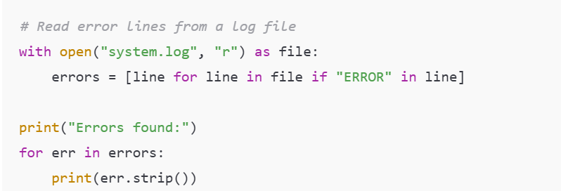
Log File Reader (Error Monitoring)

Slide 24
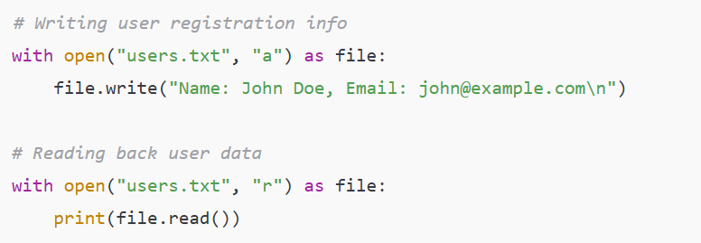
Save User Data (Registration System)

Slide 25
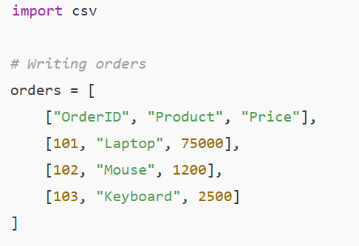
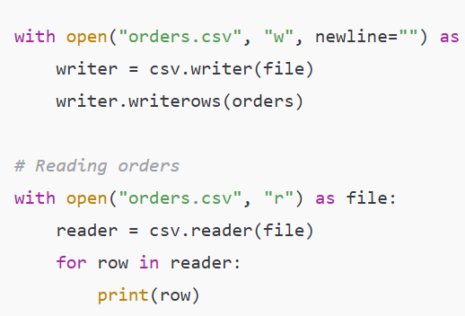
CSV File Handling (E-commerce Orders)

Slide 26
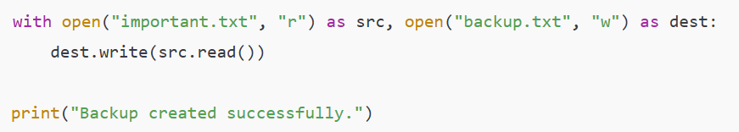
File Backup (Copy Content)

Slide 27
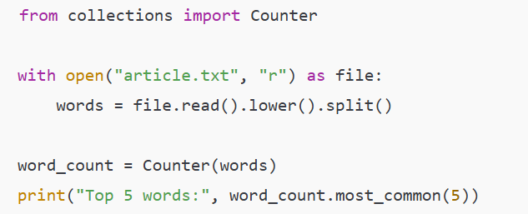
Word Counter (Text Analytics)

Slide 28
Serialization – Deserialization Pickling – unpickiling
Serialization is the process of transforming data or an object in memory (RAM) to a stream of bytes called byte streams. These byte streams in a binary file can then be stored in a disk or in a database or sent through a network. Serialization process is also called pickling.
De-serialization or unpickling is the inverse of pickling process where a byte stream is converted back to Python object.

Slide 29
The dump() method
convert (pickling) Python objects for writing data in a binary file. The file in which data are to be dumped, needs to be opened in binary write mode (wb).
Syntax of dump() is as follows:
dump (data_object, file_object)
import pickle listvalues=[1,“Geetika”,‘F’, 26] fileobject=open(“mybinary.dat”, “wb”) pickle.dump(listvalues,fileobject) fileobject.close()

Slide 30
The load() method
This method is used to load (unpickling) data from a binary file. The file to be loaded is opened in binary read (rb) mode. Syntax of load() is as follows:
Store_object load(file_object)
import pickle print(“The data that were stored in file are: “) fileobject=open(“mybinary.dat”,“rb”) objectvar=pickle.load(fileobject) fileobject.close() print(objectvar)

Slide 31
#Program to write and read employee records in a binary file import pickle print(“WORKING WITH BINARY FILES”) bfile=open(“empfile.dat”,“ab”) recno=1 print (“Enter Records of Employees”) print() #taking data from user and dumping in the file as list object while True: print(“RECORD No.”, recno) eno=int(input("\tEmployee number : “)) ename=input("\tEmployee Name : “) ebasic=int(input("\tBasic Salary : “)) allow=int(input("\tAllowances : “)) totsal=ebasic+allow print("\tTOTAL SALARY : “, totsal) edata=[eno,ename,ebasic,allow,totsal] pickle.dump(edata,bfile) ans=input(“Do you wish to enter more records (y/n)? “) recno=recno+1 if ans.lower()==‘n’: print(“Record entry OVER “) print() break

Slide 32
#retrieving the size of file print(“Size of binary file (in bytes):",bfile.tell()) bfile.close() #Reading the employee records from the file using load() module print(“Now reading the employee records from the file”) print() readrec=1 try: with open(“empfile.dat”,“rb”) as bfile: while True: edata=pickle.load(bfile) print(“Record Number : “,readrec) print(edata) readrec=readrec+1 except EOFError: pass bfile.close()

Slide 33
Regular Expression-regex

Slide 34
introduction
A Regular Expression or RegEx is a special sequence of characters that uses a search pattern to find a string or set of strings.
It can detect the presence or absence of a text by matching it with a particular pattern and also can split a pattern into one or more sub-patterns.
import re

Slide 35
How to Use RegEx in Python?
import re
s = 'GeeksforGeeks: A computer science portal for geeks'
match = re.search(r'portal', s)
print('Start Index:', match.start())
print('End Index:', match.end())

Slide 36
1. re.findall()
Returns all non-overlapping matches of a pattern in the string as a list. It scans the string from left to right.
Example: This code uses regular expression \d+ to find all sequences of one or more digits in the given string.
Example
import re
string = """Hello my Number is 123456789 and
my friend's number is 987654321"""
regex = '\d+'
match = re.findall(regex, string)
print(match)

Slide 37
2. re.compile()
Compiles a regex into a pattern object, which can be reused for matching or substitutions.
Example 1: This pattern [a-e] matches all lowercase letters between 'a' and 'e', in the input string "Aye, said Mr. Gibenson Stark". The output should be ['e', 'a', 'd', 'b', 'e'], which are matching characters.
import re
p = re.compile('[a-e]')
print(p.findall("Aye, said Mr. Gibenson Stark"))

Slide 38
Word and non-word characters
\w matches a single word character.
\w+ matches a group of word characters.
\W matches non-word characters.
mport re
p = re.compile('\w')
print(p.findall("He said * in some_lang."))
p = re.compile('\w+')
print(p.findall("I went to him at 11 A.M., he \
said *** in some_language."))
p = re.compile('\W')
print(p.findall("he said *** in some_language."))

Slide 39
Example
The regular expression pattern 'ab*' to find and list all occurrences of 'ab' followed by zero or more 'b' characters. In the input string "ababbaabbb". It returns the following list of matches: ['ab', 'abb', 'abbb’].
import re
p = re.compile('ab*')
print(p.findall("ababbaabbb"))

Slide 40
3. re.split()
Splits a string wherever the pattern matches. The remaining characters are returned as list elements.
Syntax:
re.split(pattern, string, maxsplit=0, flags=0)
pattern: Regular expression to match split points.
string: The input string to split.
maxsplit (optional): Limits the number of splits. Default is 0 (no limit).
flags (optional): Apply regex flags like re.IGNORECASE.

Slide 41
Example
Splitting by non-word characters or digits
This example demonstrates how to split a string using different patterns like non-word characters (\W+), apostrophes, and digits (\d+).
from re import split
print(split('\W+', 'Words, words , Words'))
print(split('\W+', "Word's words Words"))
print(split('\W+', 'On 12th Jan 2016, at 11:02 AM'))
print(split('\d+', 'On 12th Jan 2016, at 11:02 AM'))

Slide 42
4. re.sub()
The re.sub() function replaces all occurrences of a pattern in a string with a replacement string.
Syntax:
re.sub(pattern, repl, string, count=0, flags=0)
pattern: The regex pattern to search for.
repl: The string to replace matches with.
string: The input string to process.
count (optional): Maximum number of substitutions (default is 0, which means replace all).
flags (optional): Regex flags like re.IGNORECASE.

Slide 43
different ways to replace the pattern 'ub' with '~*', using various flags and count values.
import re
# Case-insensitive replacement of all 'ub'
print(re.sub('ub', '~*', 'Subject has Uber booked already', flags=re.IGNORECASE))
# Case-sensitive replacement of all 'ub'
print(re.sub('ub', '~*', 'Subject has Uber booked already'))
# Replace only the first 'ub', case-insensitive
print(re.sub('ub', '~*', 'Subject has Uber booked already', count=1, flags=re.IGNORECASE))
# Replace "AND" with "&", ignoring case
print(re.sub(r'\sAND\s', ' & ', 'Baked Beans And Spam', flags=re.IGNORECASE))

Slide 44
[] - Square Brackets
import re
string = "The quick brown fox jumps over the lazy dog"
pattern = "[a-m]"
result = re.findall(pattern, string)
print(result)

Slide 45
^ - Caret
It matches the beginning of the string i.e. checks whether the string starts with the given character(s) or not. For example -
^g will check if the string starts with g such as geeks, globe, girl, g, etc.
^ge will check if the string starts with ge such as geeks, geeksforgeeks, etc.
Example: This code uses regular expressions to check if a list of strings starts with "The". If a string begins with "The," it's marked as "Matched" otherwise, it's labeled as "Not matched".
import re
regex = r'^The'
strings = ['The quick brown fox', 'The lazy dog', 'A quick brown fox']
for string in strings:
if re.match(regex, string):
print(f'Matched: {string}')
else:
print(f'Not matched: {string}')

Slide 46
$ - Dollar
It matches the end of the string i.e checks whether the string ends with the given character(s) or not. For example-
s$ will check for the string that ends with a such as geeks, ends, s, etc.
ks$ will check for the string that ends with ks such as geeks, geeksforgeeks, ks, etc.
Example: This code uses a regular expression to check if the string ends with "World!". If a match is found, it prints "Match found!" otherwise, it prints "Match not found".
import re
string = "Hello World!"
pattern = r"World!$"
match = re.search(pattern, string)
if match:
print("Match found!")
else:
print("Match not found.")

Slide 47

Thank you
Rakhee.chhibber@hcltech.com

